Slide 1


Schoology Tutorials for Schoology: Beginning of the Year

Slide 2

How to login to Schoology
Students will need their username and passwords
Suggestions: practice logging in and out 3-5 times after watching the video
Suggestion: Have paper keyboards students can practice on
Reward students who memorize their username and password, after practicing, see if they can all log in within a certain time frame and reward them.
Place your screenshot here

Slide 3
How to connect Google Drive on Schoology
This is a one time setup but must be done to allow permission for Schoology and Google Drive to talk to each other and the systems to have access to Google Docs and Slides when you have assignments to turn in or view the work that needs to be completed.

Slide 4
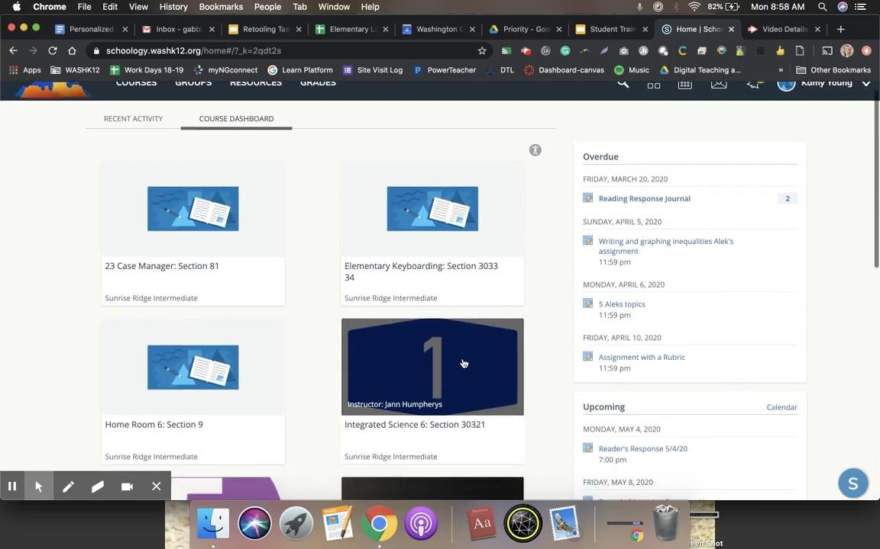
How to View Courses
Have students practice finding their course(s) and knowing how to find the teachers name. This is helpful at the beginning of the year.

Slide 5
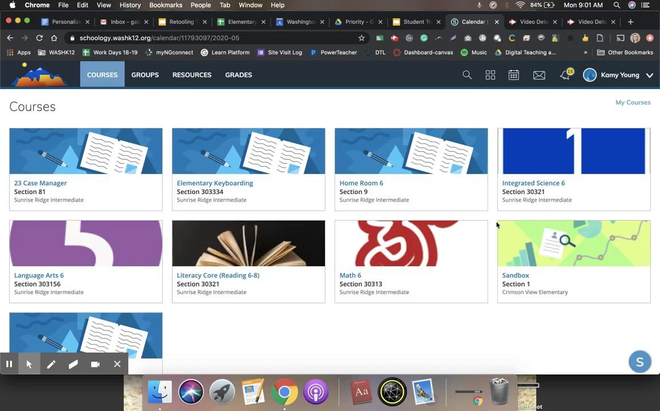
Knowing the Dashboard Icons and what they mean
View Upcoming Assignments
View Overdue Assignments
Bell Icon & Notifications
Student Calendar

Slide 6
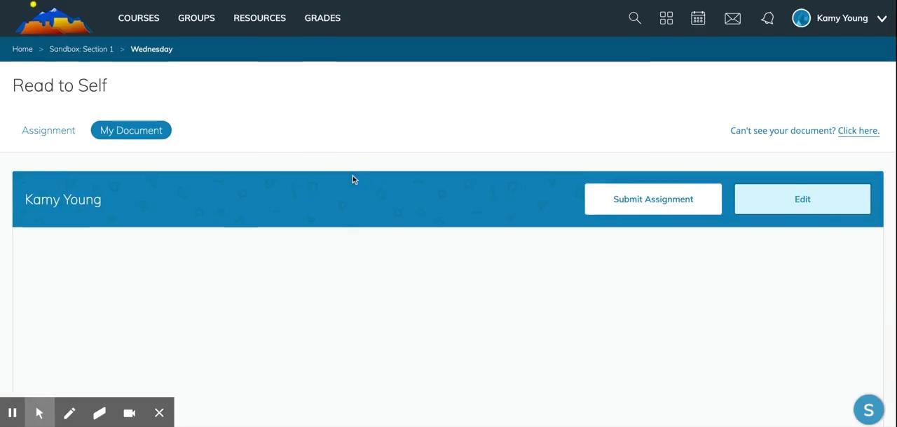
How to Submit different kinds of assignments
1st: Submitting a Google Doc or Slide (0:10)
2nd: Submitting a file, link, using audio/video (1:30)
Place your screnshot here

Slide 7
How to post a discussion and use the features
Go over suggested expectations for Discussion posts. Ideas could be using complete sentences, grammar and punctuation. Respond academically to your peers. Practice responding with text and audio/video
Teacher Suggestions: Post an example post for students to see. Give Sentence starters for practice and word banks for students to use in their responses.

Slide 8
How to use the Student Portfolio
Located in your personal profile, Portfolios make it easy to showcase your personality, your interests, and your talents.
And as you already know, building a solid portfolio is a necessary skill for many career paths.

Slide 9
Student Completion View
Students will only see this button if the teacher has set up the parameters for student completion rules.

Slide 10
Test/Quiz
This video showcases the different types of questions on a test/quiz within Schoology. This is the test/quiz feature. Not AMP.
Suggestion: do a practice quiz where students can practice answering the different types of questions.

Slide 11
SORA & ConnectED/
McGraw-Hill

Slide 12

Free templates for all your presentation needs
For PowerPoint and Google Slides
100% free for personal or commercial use
Ready to use, professional and customizable
Blow your audience away with attractive visuals

